Slide 1
GJK with distance
ycw
20230719

Slide 2
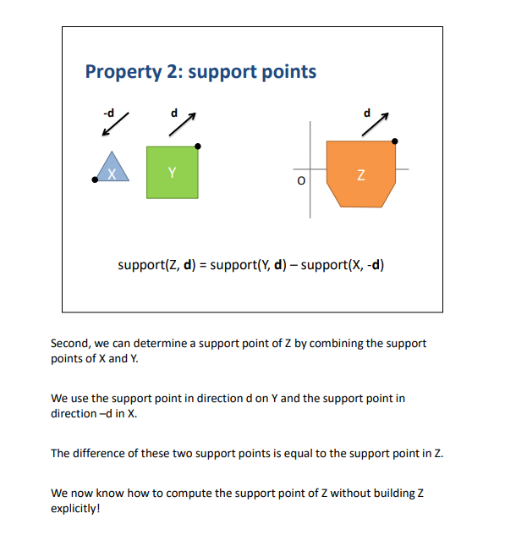
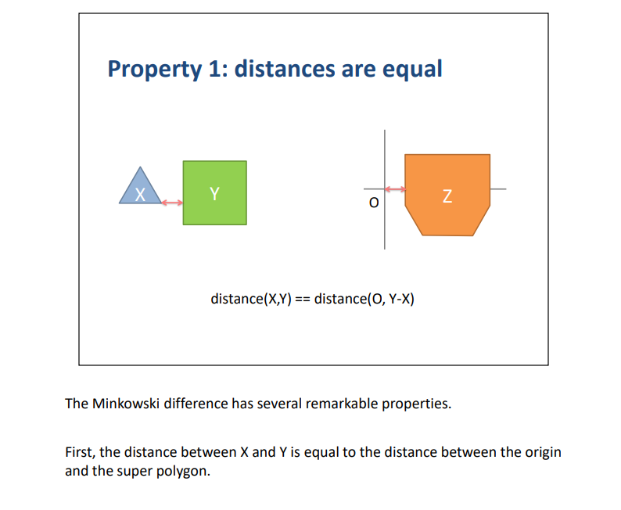
Minkowski difference
ErinCatto_GJK_GDC2010.pdf (box2d.org)

Slide 3
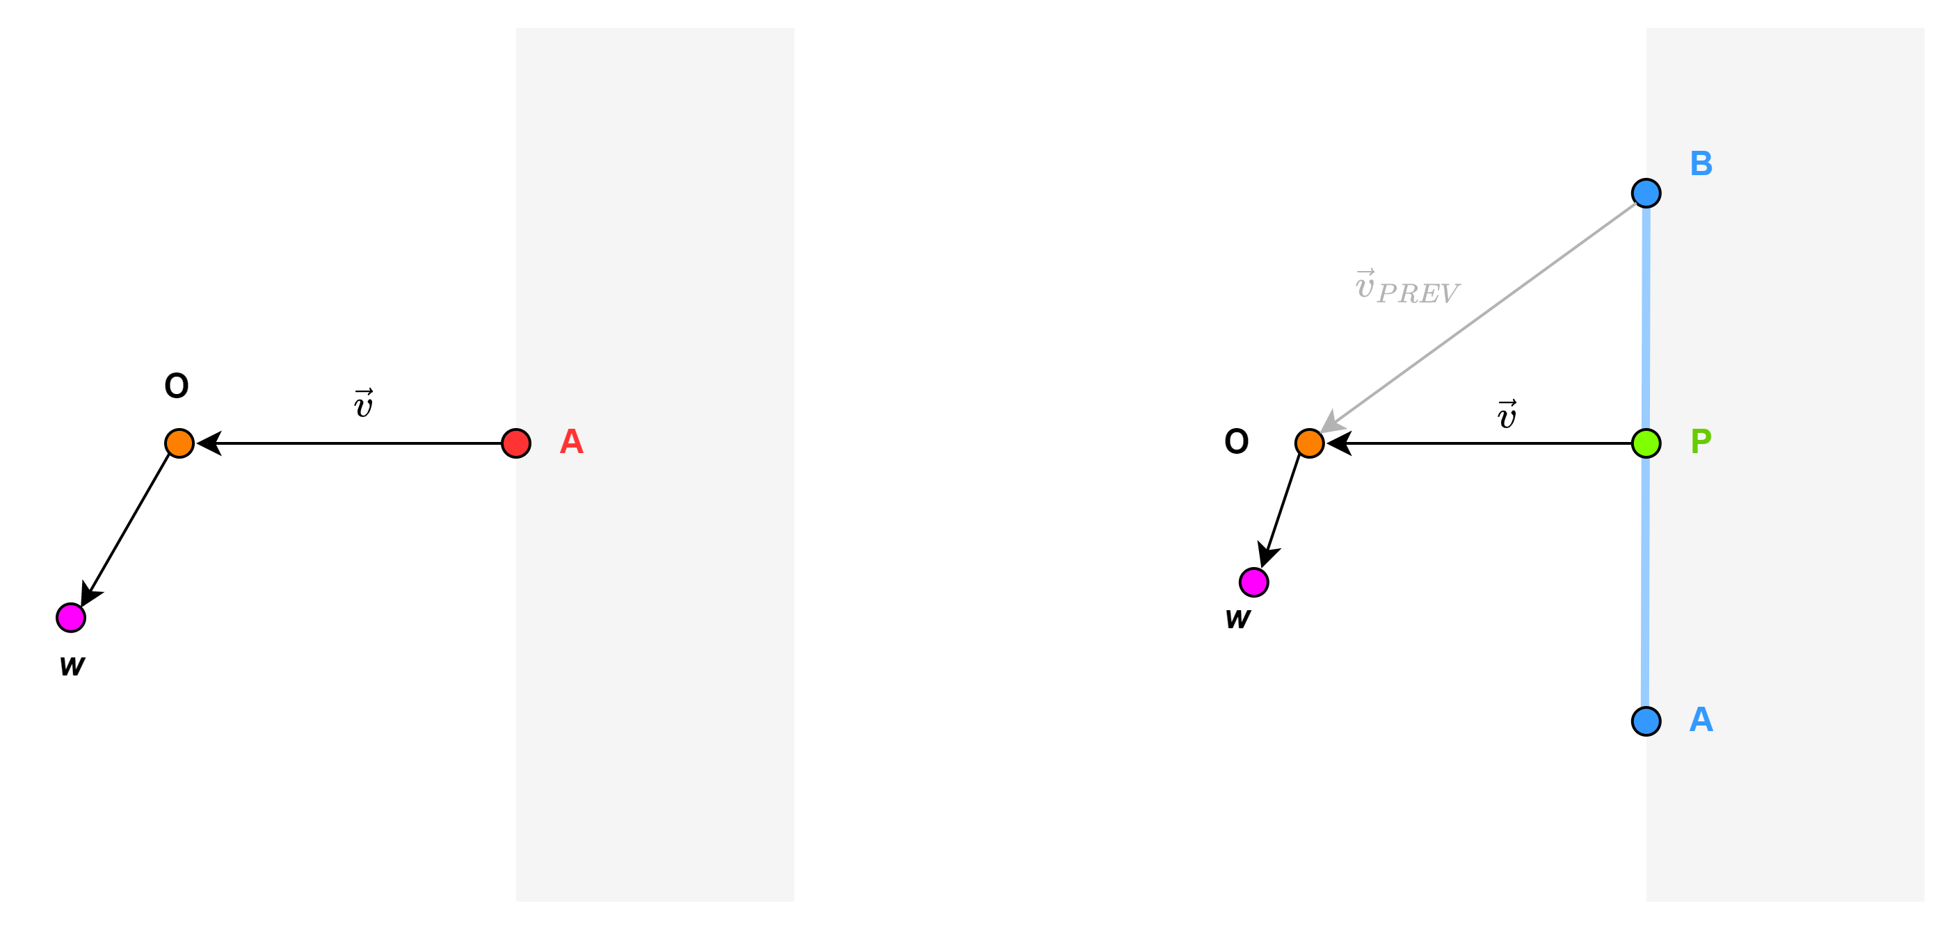
Find support point: Search vector
The start point of the search vector is always selected to be the point on the simplex that is nearest to the origin.
The end point of the search vector is always the origin.
w is the coordinates of the found support point
Point simplex case
Line simplex case
Assume origin does not coincide with the simplex
Note that w cannot lie in the area opposite of the search direction (grey area) (see next slide for reasoning)

Slide 4
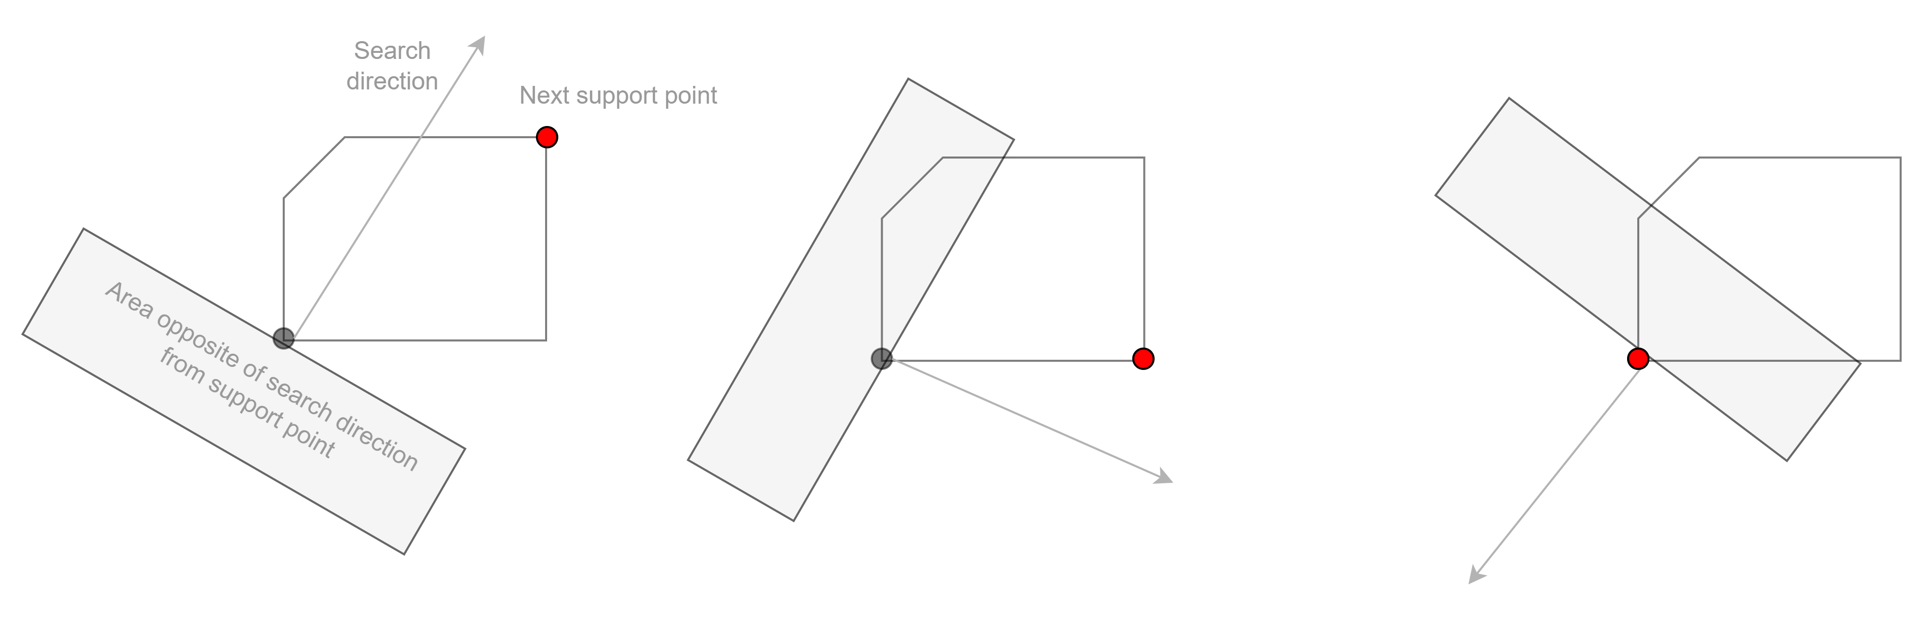
Reasoning: Next support point cannot lie in the area opposite of the search direction

Slide 5
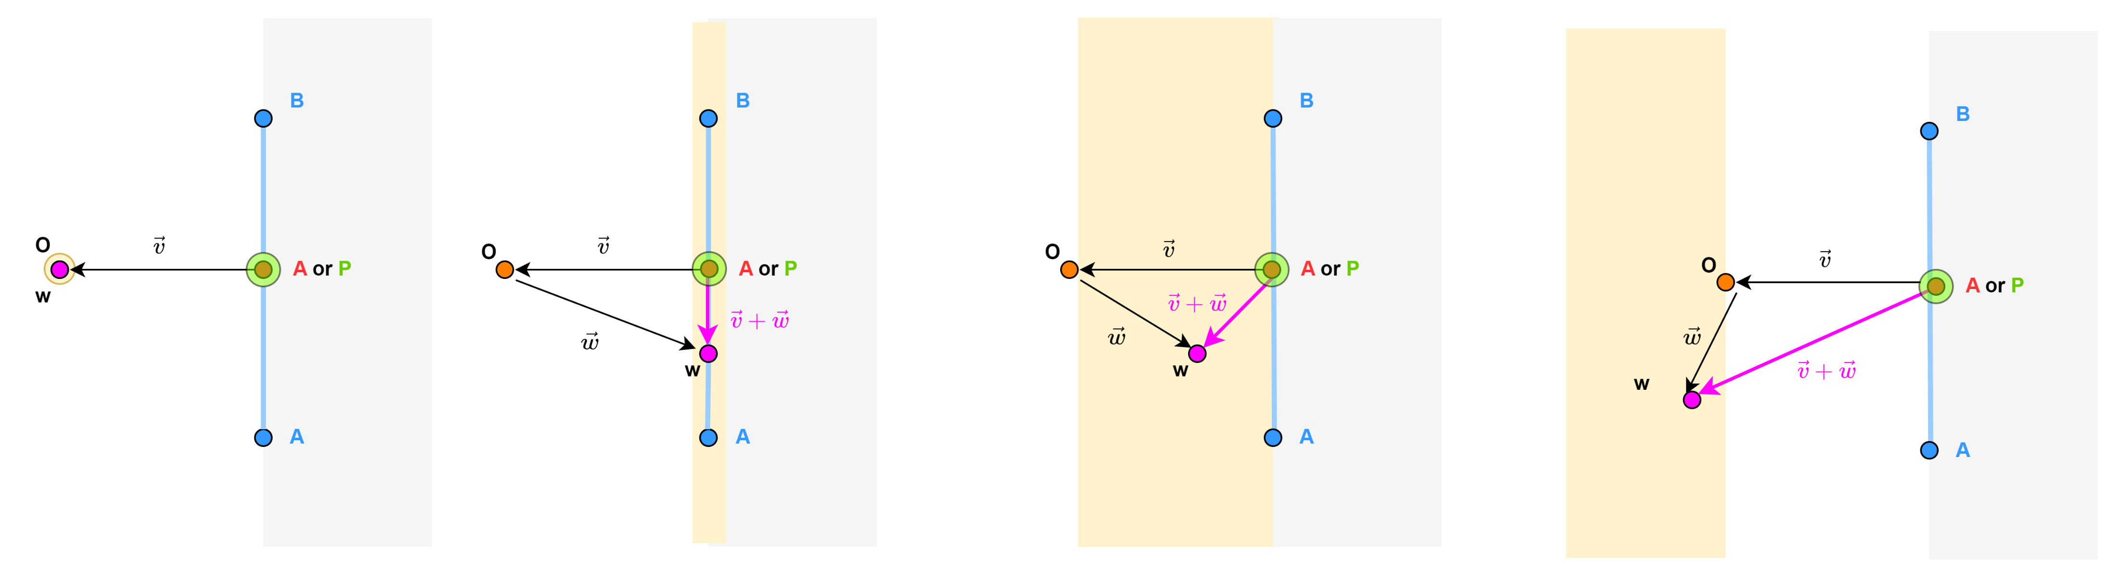

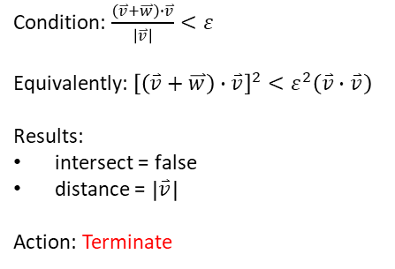

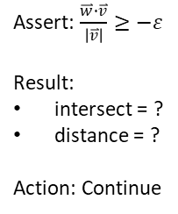
Find support point: Cases
Case 1
Else
Case 2
Else
Case 3
Else
Case 4
Condition: $\frac{\left(\overset{⃑}{v}+\overset{⃑}{w}\right)∙\overset{⃑}{v}}{\left|\overset{⃑}{v}\right|}<ε$
Equivalently: ${\left[\left(\overset{⃑}{v}+\overset{⃑}{w}\right)∙\overset{⃑}{v}\right]}^{2}<ε^{2}\left(\overset{⃑}{v}∙\overset{⃑}{v}\right)$
Results:
intersect = false
distance = $\left|\overset{⃑}{v}\right|$
Action: Terminate
Condition: $\frac{\overset{⃑}{w}∙\overset{⃑}{v}}{\left|\overset{⃑}{v}\right|}<−ε$
Equivalently:
$\overset{⃑}{w}∙\overset{⃑}{v}<0$ and
${\left(\overset{⃑}{w}∙\overset{⃑}{v}\right)}^{2}>$ $ε^{2}\left(\overset{⃑}{v}∙\overset{⃑}{v}\right)$
Result:
intersect = false
distance = ?
Action: Continue
Assert: $\frac{\overset{⃑}{w}∙\overset{⃑}{v}}{\left|\overset{⃑}{v}\right|}≥−ε$
Result:
intersect = ?
distance = ?
Action: Continue
Condition:$\left|\overset{⃑}{w}\right|<ε$
Equivalently: $\overset{⃑}{w}∙\overset{⃑}{w}$ < $ε$²
Results:
intersect = true
distance = $0$
Action: Terminate
Can be a terminating condition if distance is not required

Slide 6
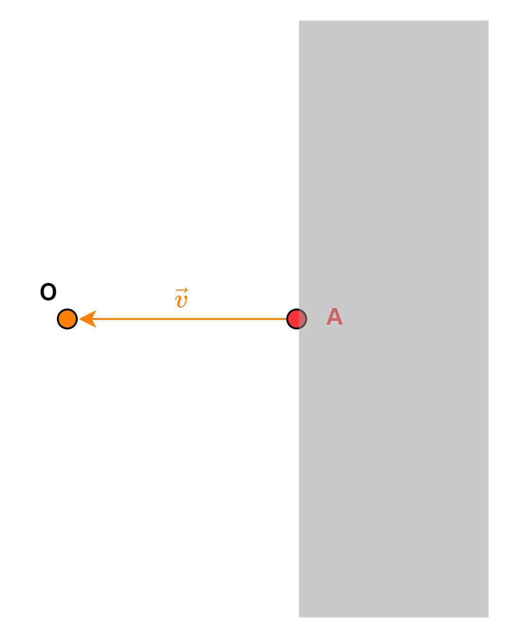
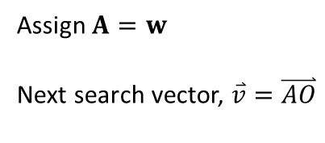
Update simplex: S0D
Assign $A=w$
Next search vector, $\overset{⃑}{v}=\overset{⃑}{AO}$

Slide 7
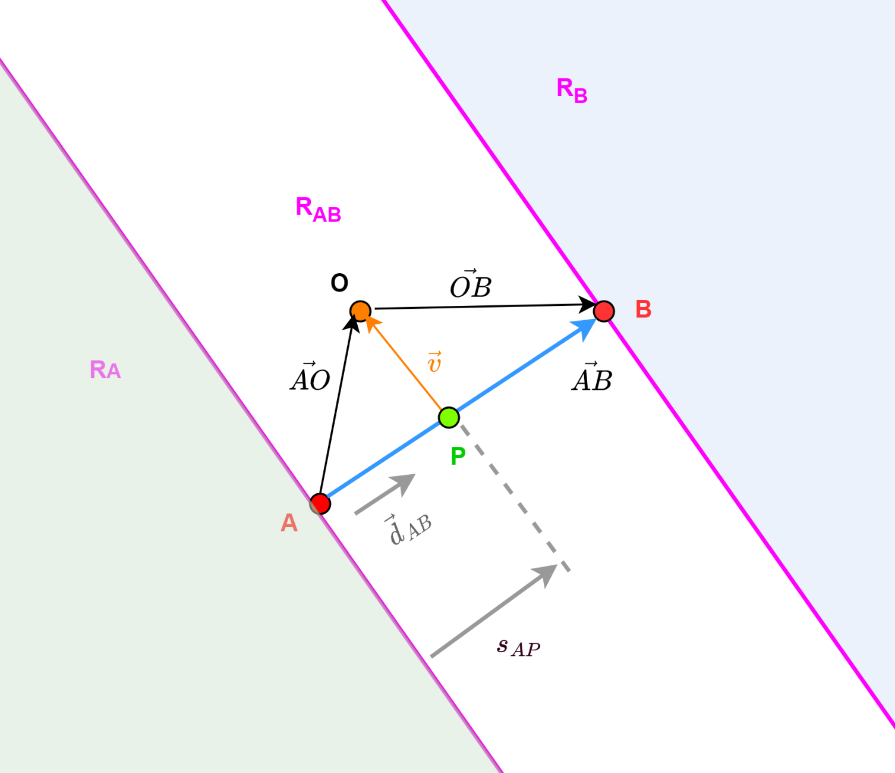
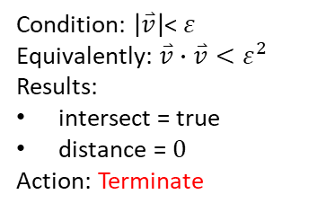


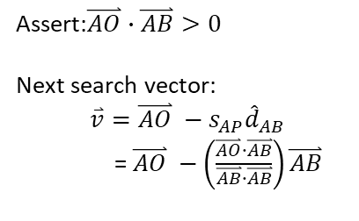
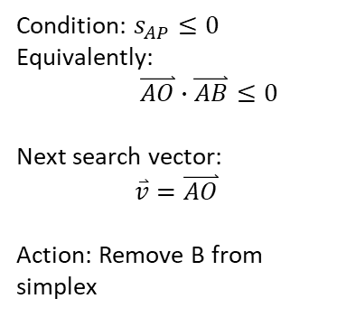
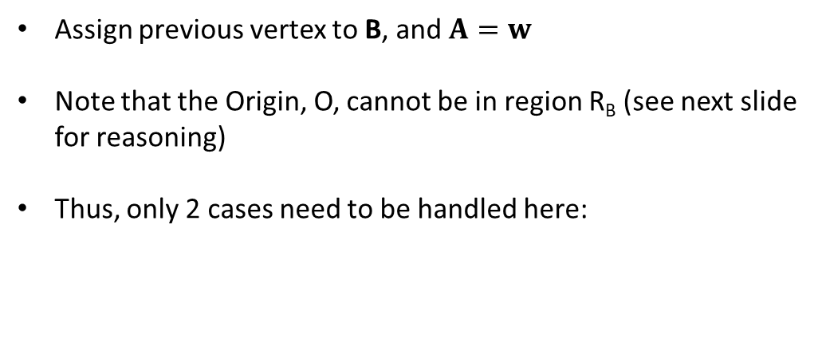
Update simplex: S1D
Assign previous vertex to B, and $A=w$
Note that the Origin, O, cannot be in region R_{B} (see next slide for reasoning)
Thus, only 2 cases need to be handled here:
Case 1: Origin in R_{A}
Else
Case 2: Origin in R_{AB}
Condition: $s_{AP}≤0$ Equivalently:
$\overset{⃑}{AO}∙\overset{⃑}{AB}≤0$
Next search vector:
$$\overset{⃑}{v}=\overset{⃑}{AO}$$
Action: Remove B from simplex
Assert:$\overset{⃑}{AO}∙\overset{⃑}{AB}>0$
Next search vector:
$\overset{⃑}{v}={\overset{⃑}{AO} −s}_{AP}{\hat{d}}_{AB}$
= $\overset{⃑}{AO} −\left(\frac{\overset{⃑}{AO}∙\overset{⃑}{AB}}{\overset{⃑}{AB}∙\overset{⃑}{AB}}\right)\overset{⃑}{AB}$
$${\hat{d}}_{AB}=\frac{\overset{⃑}{AB}}{\left|\overset{⃑}{AB}\right|}$$
$$s_{AP}=\overset{⃑}{AO}∙ {\hat{d}}_{AB}$$
Condition: $\left|\overset{⃑}{v}\right|\text{<} ε$
Equivalently: $\overset{⃑}{v}∙\overset{⃑}{v}<ε^{2}$
Results:
intersect = true
distance = $0$
Action: Terminate
In the version of GJK not calculating distance, this case will not happen. As this would correspond to Case 3 in the find support point routine, and be terminated.

Slide 8
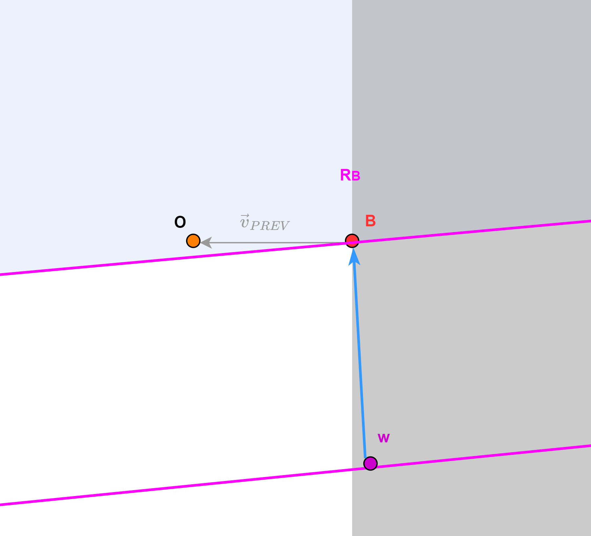
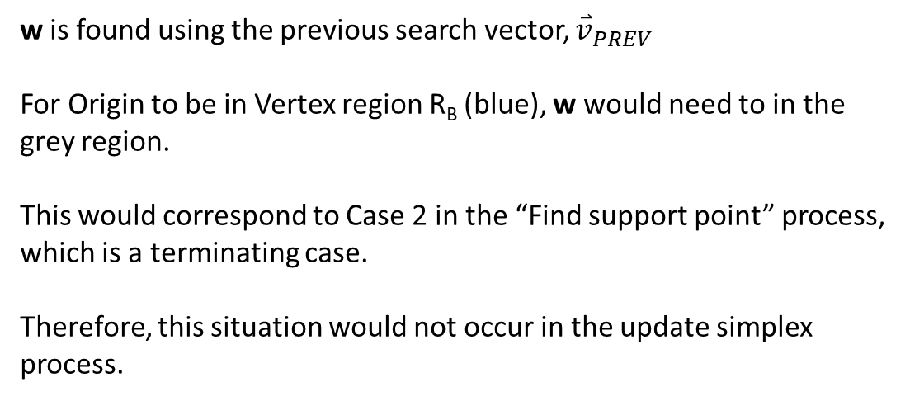
Reasoning: origin cannot be in vertex region R_{B}
w is found using the previous search vector, ${\overset{⃑}{v}}_{PREV}$
For Origin to be in Vertex region R_{B} (blue), w would need to in the grey region.
This would correspond to Case 2 in the “Find support point” process, which is a terminating case.
Therefore, this situation would not occur in the update simplex process.

Slide 9
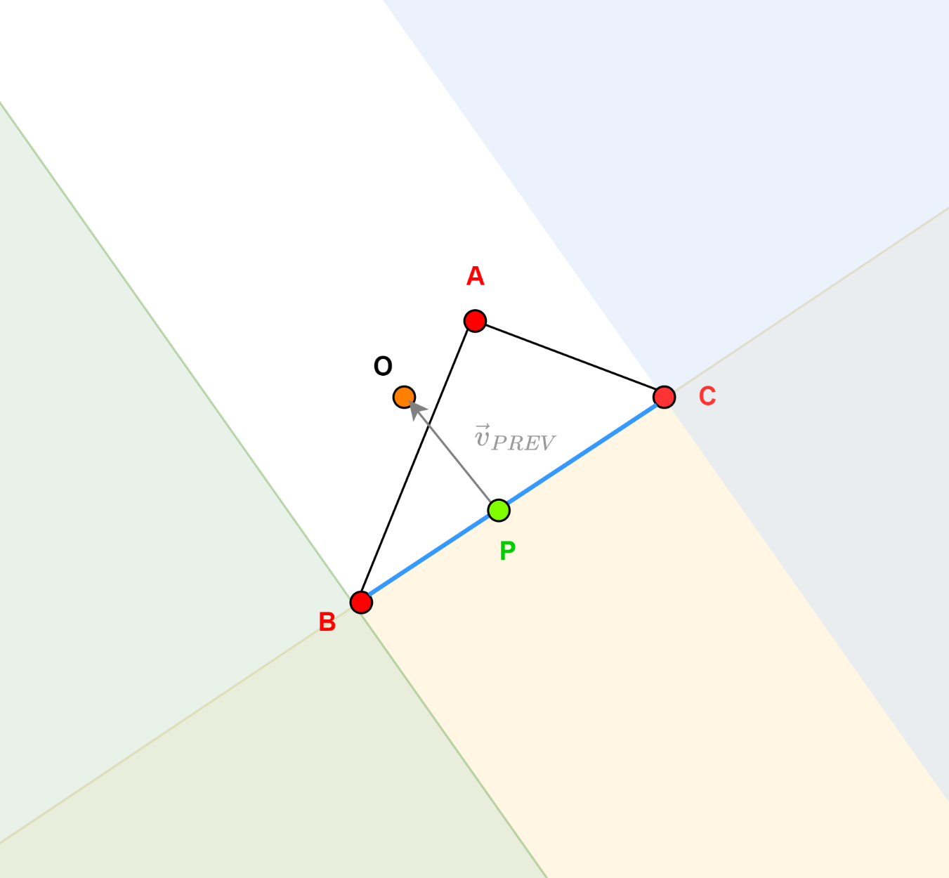
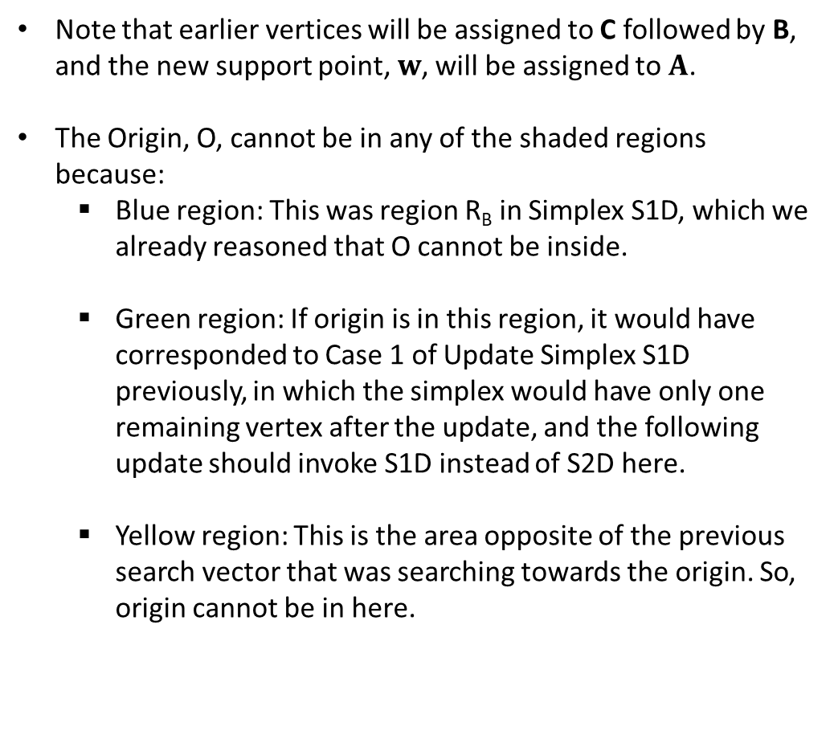
Update simplex: S2D – regions of interest
Note that earlier vertices will be assigned to C followed by B, and the new support point, $w$, will be assigned to $A$.
The Origin, O, cannot be in any of the shaded regions because:
Blue region: This was region R_{B} in Simplex S1D, which we already reasoned that O cannot be inside.
Green region: If origin is in this region, it would have corresponded to Case 1 of Update Simplex S1D previously, in which the simplex would have only one remaining vertex after the update, and the following update should invoke S1D instead of S2D here.
Yellow region: This is the area opposite of the previous search vector that was searching towards the origin. So, origin cannot be in here.

Slide 10
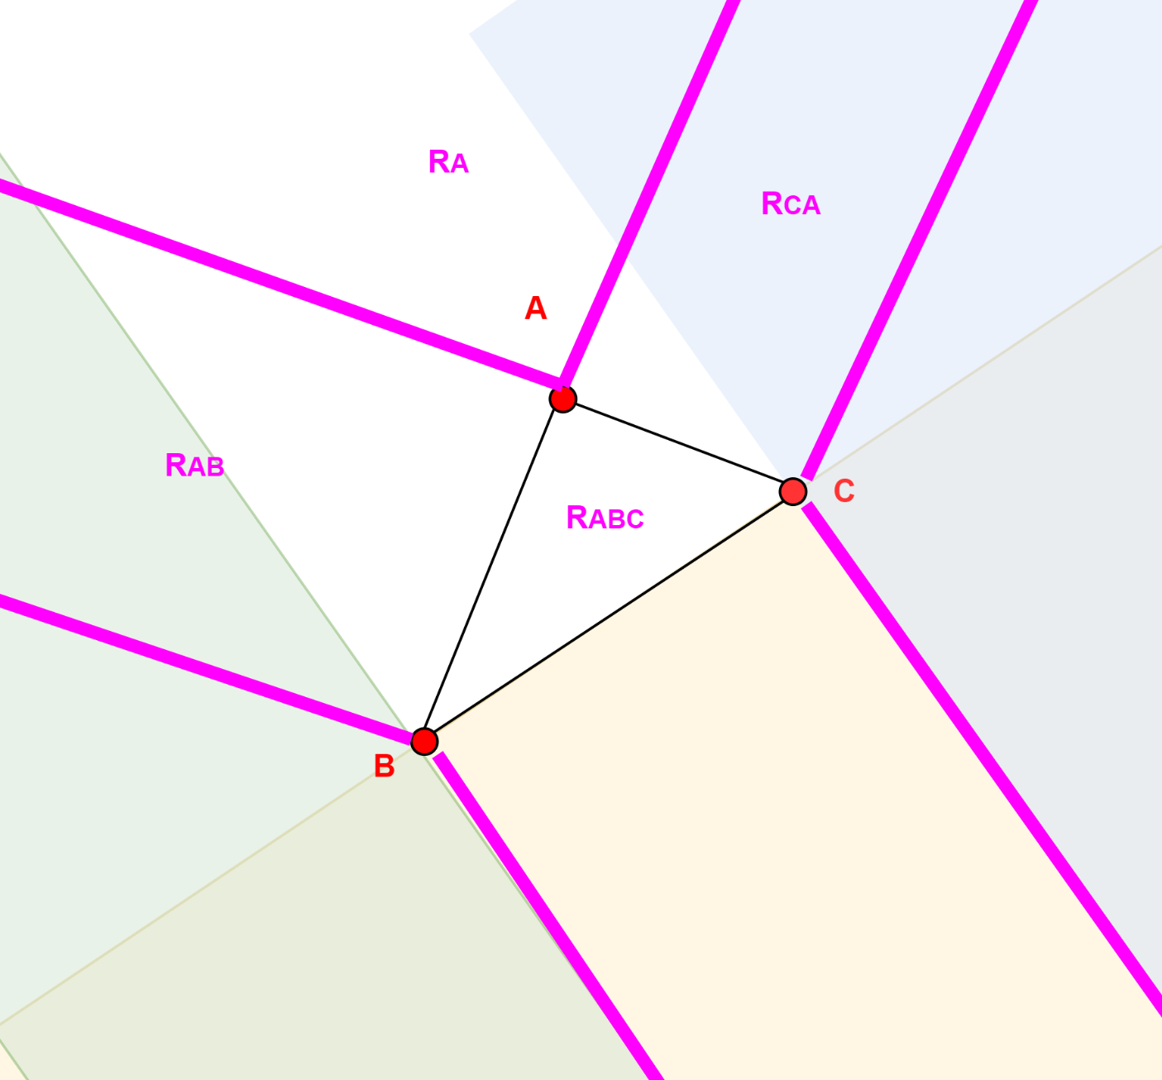
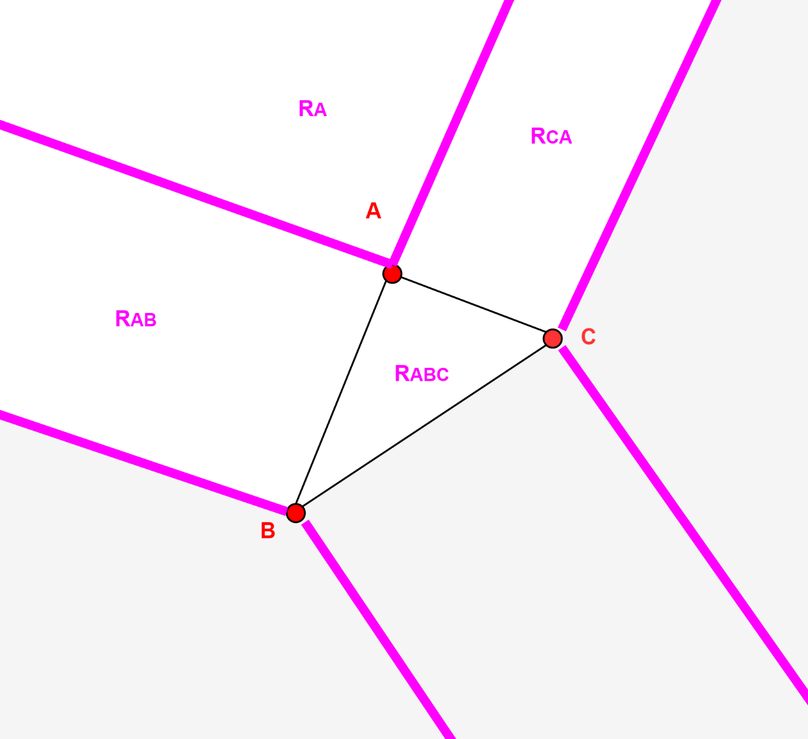
Update simplex: S2D – regions of interest
Overlay Voronoi regions
Voronoi regions (grey) that we can totally not consider

Slide 11

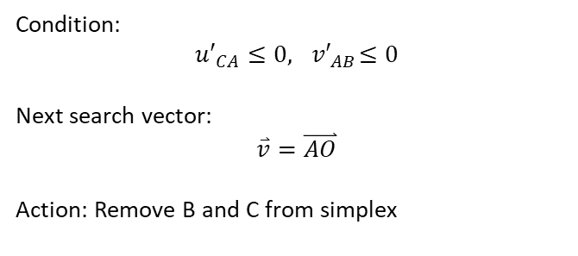
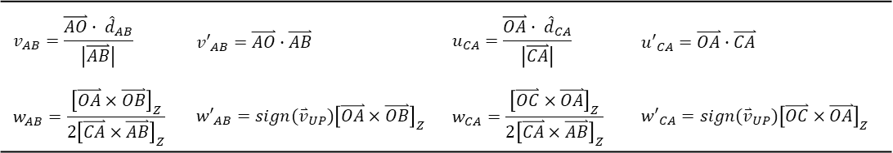
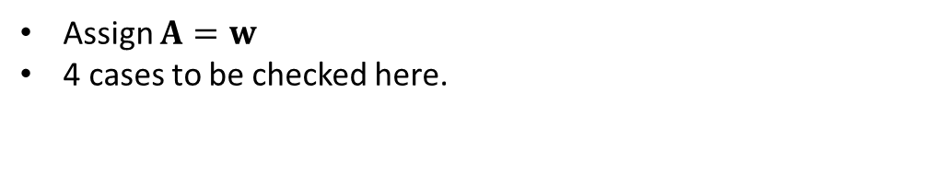

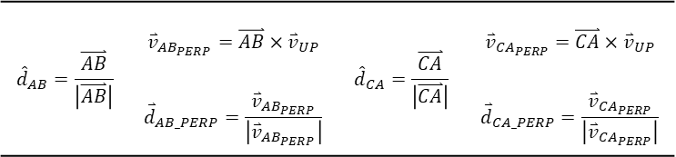
Update simplex: S2D
Assign $A=w$
4 cases to be checked here.
Case 1: Origin in R_{A}
Else
Case 2: Origin in R_{AB}
Else
Case 4: Origin in R_{ABC}
Else
Case 3: Origin in R_{CA}
Case 1: Origin in R_{A}
Condition:
$${u′}_{CA}≤0,{ v′}_{AB}≤0$$
Next search vector:
$$\overset{⃑}{v}=\overset{⃑}{AO}$$
Action: Remove B and C from simplex
$${\overset{⃑}{v}}_{UP}=\overset{⃑}{CA}×\overset{⃑}{AB}$$
$${\hat{d}}_{AB}=\frac{\overset{⃑}{AB}}{\left|\overset{⃑}{AB}\right|}$$ | $${\overset{⃑}{v}}_{AB_{PERP}}=\overset{⃑}{AB}×{\overset{⃑}{v}}_{UP}$$ | $${\hat{d}}_{CA}=\frac{\overset{⃑}{CA}}{\left|\overset{⃑}{CA}\right|}$$ | $${\overset{⃑}{v}}_{{CA}_{PERP}}=\overset{⃑}{CA}×{\overset{⃑}{v}}_{UP}$$
 | $${\overset{⃑}{d}}_{AB_PERP}=\frac{{\overset{⃑}{v}}_{AB_{PERP}}}{\left|{\overset{⃑}{v}}_{AB_{PERP}}\right|}$$ |  | $${\overset{⃑}{d}}_{CA_PERP}=\frac{{\overset{⃑}{v}}_{{CA}_{PERP}}}{\left|{\overset{⃑}{v}}_{{CA}_{PERP}}\right|}$$
$$v_{AB}=\frac{\overset{⃑}{AO}∙ {\hat{d}}_{AB}}{\left|\overset{⃑}{AB}\right|}$$ | $${v′}_{AB}=\overset{⃑}{AO}∙\overset{⃑}{AB}$$ | $$u_{CA}=\frac{\overset{⃑}{OA}∙ {\hat{d}}_{CA}}{\left|\overset{⃑}{CA}\right|}$$ | $${u′}_{CA}=\overset{⃑}{OA}∙\overset{⃑}{CA}$$
$$w_{AB}=\frac{{\left[\overset{⃑}{OA}×\overset{⃑}{OB}\right]}_{Z}}{{2\left[\overset{⃑}{CA}×\overset{⃑}{AB}\right]}_{Z}}$$ | $${w′}_{AB}=sign({\overset{⃑}{v}}_{UP}){\left[\overset{⃑}{OA}×\overset{⃑}{OB}\right]}_{Z}$$ | $$w_{CA}=\frac{{\left[\overset{⃑}{OC}×\overset{⃑}{OA}\right]}_{Z}}{{2\left[\overset{⃑}{CA}×\overset{⃑}{AB}\right]}_{Z}}$$ | $${w′}_{CA}=sign({\overset{⃑}{v}}_{UP}){\left[\overset{⃑}{OC}×\overset{⃑}{OA}\right]}_{Z}$$
Refer: “Computing distance of a point to triangle.pptx”

Slide 12

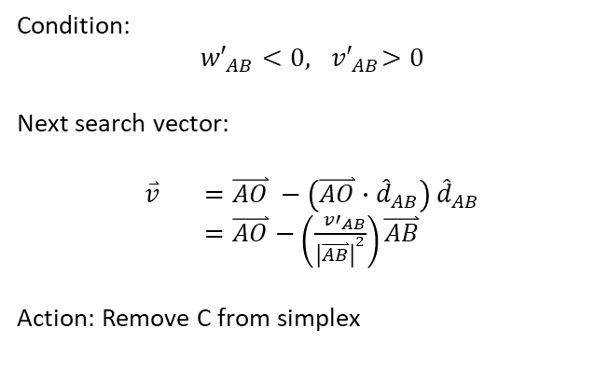
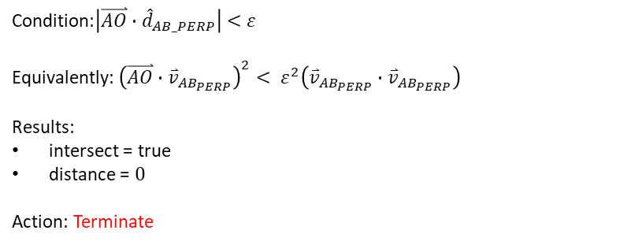
Update simplex: S2D
Case 2: Origin in R_{AB}
Case 2A: Origin on line AB
Condition:$\left|\overset{⃑}{AO}∙{\hat{d}}_{AB_PERP}\right|<$ $ε$
Equivalently: ${\left(\overset{⃑}{AO}∙{\overset{⃑}{v}}_{AB_{PERP}}\right)}^{2}< ε^{2}\left({\overset{⃑}{v}}_{AB_{PERP}}∙{\overset{⃑}{v}}_{AB_{PERP}}\right)$
Results:
intersect = true
distance = $0$
Action: Terminate
Case 2B: Origin in R_{AB} exclude line AB
$${\overset{⃑}{v}}_{UP}=\overset{⃑}{CA}×\overset{⃑}{AB}$$
Condition:
$${w′}_{AB}<0,{ v′}_{AB}>0$$
Next search vector:
$\overset{⃑}{v} =\overset{⃑}{AO} −\left(\overset{⃑}{AO}{∙\hat{d}}_{AB}\right)$ ${\hat{d}}_{AB}$
$=\overset{⃑}{AO}$ $−\left(\frac{{ v′}_{AB}}{{\left|\overset{⃑}{AB}\right|}^{2}}\right)\overset{⃑}{AB}$
Action: Remove C from simplex
$${\hat{d}}_{AB}=\frac{\overset{⃑}{AB}}{\left|\overset{⃑}{AB}\right|}$$ | $${\overset{⃑}{v}}_{AB_{PERP}}=\overset{⃑}{AB}×{\overset{⃑}{v}}_{UP}$$ | $${\hat{d}}_{CA}=\frac{\overset{⃑}{CA}}{\left|\overset{⃑}{CA}\right|}$$ | $${\overset{⃑}{v}}_{{CA}_{PERP}}=\overset{⃑}{CA}×{\overset{⃑}{v}}_{UP}$$
 | $${\overset{⃑}{d}}_{AB_PERP}=\frac{{\overset{⃑}{v}}_{AB_{PERP}}}{\left|{\overset{⃑}{v}}_{AB_{PERP}}\right|}$$ |  | $${\overset{⃑}{d}}_{CA_PERP}=\frac{{\overset{⃑}{v}}_{{CA}_{PERP}}}{\left|{\overset{⃑}{v}}_{{CA}_{PERP}}\right|}$$
$$v_{AB}=\frac{\overset{⃑}{AO}∙ {\hat{d}}_{AB}}{\left|\overset{⃑}{AB}\right|}$$ | $${v′}_{AB}=\overset{⃑}{AO}∙\overset{⃑}{AB}$$ | $$u_{CA}=\frac{\overset{⃑}{OA}∙ {\hat{d}}_{CA}}{\left|\overset{⃑}{CA}\right|}$$ | $${u′}_{CA}=\overset{⃑}{OA}∙\overset{⃑}{CA}$$
$$w_{AB}=\frac{{\left[\overset{⃑}{OA}×\overset{⃑}{OB}\right]}_{Z}}{{2\left[\overset{⃑}{CA}×\overset{⃑}{AB}\right]}_{Z}}$$ | $${w′}_{AB}=sign({\overset{⃑}{v}}_{UP}){\left[\overset{⃑}{OA}×\overset{⃑}{OB}\right]}_{Z}$$ | $$w_{CA}=\frac{{\left[\overset{⃑}{OC}×\overset{⃑}{OA}\right]}_{Z}}{{2\left[\overset{⃑}{CA}×\overset{⃑}{AB}\right]}_{Z}}$$ | $${w′}_{CA}=sign({\overset{⃑}{v}}_{UP}){\left[\overset{⃑}{OC}×\overset{⃑}{OA}\right]}_{Z}$$
Refer: “Computing distance of a point to triangle.pptx”

Slide 13

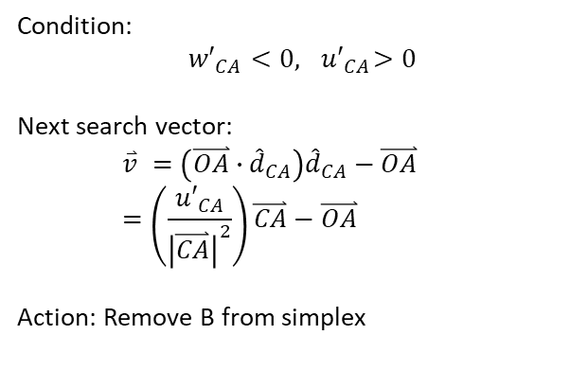
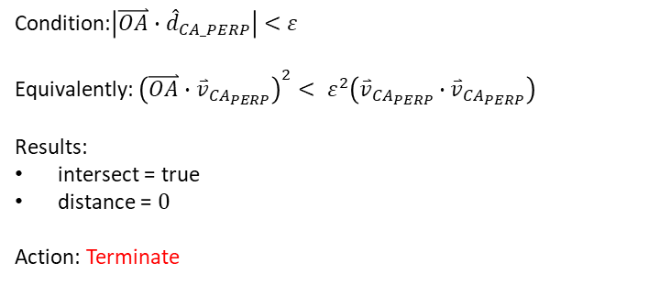
Update simplex: S2D
Case 3: Origin in R_{CA}
Case 3A: Origin on line CA
Condition:$\left|\overset{⃑}{OA}∙{\hat{d}}_{CA_PERP}\right|<$ $ε$
Equivalently: ${\left(\overset{⃑}{OA}∙{\overset{⃑}{v}}_{{CA}_{PERP}}\right)}^{2}< ε^{2}\left({\overset{⃑}{v}}_{{CA}_{PERP}}∙{\overset{⃑}{v}}_{{CA}_{PERP}}\right)$
Results:
intersect = true
distance = $0$
Action: Terminate
Case 3B: Origin in R_{CA} exclude line CA
$${\overset{⃑}{v}}_{UP}=\overset{⃑}{CA}×\overset{⃑}{AB}$$
Condition:
$${w′}_{CA}<0,{ u′}_{CA}>0$$
Next search vector:
$$\overset{⃑}{v} =\left(\overset{⃑}{OA}∙{\hat{d}}_{CA}\right){\hat{d}}_{CA}−\overset{⃑}{OA} =\left(\frac{{u′}_{CA}}{{\left|\overset{⃑}{CA}\right|}^{2}}\right)\overset{⃑}{CA}−\overset{⃑}{OA}$$
Action: Remove B from simplex
$${\hat{d}}_{AB}=\frac{\overset{⃑}{AB}}{\left|\overset{⃑}{AB}\right|}$$ | $${\overset{⃑}{v}}_{AB_{PERP}}=\overset{⃑}{AB}×{\overset{⃑}{v}}_{UP}$$ | $${\hat{d}}_{CA}=\frac{\overset{⃑}{CA}}{\left|\overset{⃑}{CA}\right|}$$ | $${\overset{⃑}{v}}_{{CA}_{PERP}}=\overset{⃑}{CA}×{\overset{⃑}{v}}_{UP}$$
 | $${\overset{⃑}{d}}_{AB_PERP}=\frac{{\overset{⃑}{v}}_{AB_{PERP}}}{\left|{\overset{⃑}{v}}_{AB_{PERP}}\right|}$$ |  | $${\overset{⃑}{d}}_{CA_PERP}=\frac{{\overset{⃑}{v}}_{{CA}_{PERP}}}{\left|{\overset{⃑}{v}}_{{CA}_{PERP}}\right|}$$
$$v_{AB}=\frac{\overset{⃑}{AO}∙ {\hat{d}}_{AB}}{\left|\overset{⃑}{AB}\right|}$$ | $${v′}_{AB}=\overset{⃑}{AO}∙\overset{⃑}{AB}$$ | $$u_{CA}=\frac{\overset{⃑}{OA}∙ {\hat{d}}_{CA}}{\left|\overset{⃑}{CA}\right|}$$ | $${u′}_{CA}=\overset{⃑}{OA}∙\overset{⃑}{CA}$$
$$w_{AB}=\frac{{\left[\overset{⃑}{OA}×\overset{⃑}{OB}\right]}_{Z}}{{2\left[\overset{⃑}{CA}×\overset{⃑}{AB}\right]}_{Z}}$$ | $${w′}_{AB}=sign({\overset{⃑}{v}}_{UP}){\left[\overset{⃑}{OA}×\overset{⃑}{OB}\right]}_{Z}$$ | $$w_{CA}=\frac{{\left[\overset{⃑}{OC}×\overset{⃑}{OA}\right]}_{Z}}{{2\left[\overset{⃑}{CA}×\overset{⃑}{AB}\right]}_{Z}}$$ | $${w′}_{CA}=sign({\overset{⃑}{v}}_{UP}){\left[\overset{⃑}{OC}×\overset{⃑}{OA}\right]}_{Z}$$
Refer: “Computing distance of a point to triangle.pptx”

Slide 14
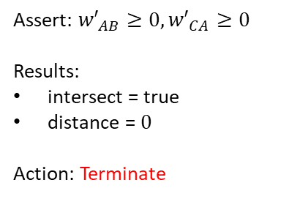
Update simplex: S2D
Case 4: Origin in R_{ABC}
Assert: ${w′}_{AB}≥0,{w′}_{CA}≥0$
Results:
intersect = true
distance = $0$
Action: Terminate
$${\overset{⃑}{v}}_{UP}=\overset{⃑}{CA}×\overset{⃑}{AB}$$
$${\hat{d}}_{AB}=\frac{\overset{⃑}{AB}}{\left|\overset{⃑}{AB}\right|}$$ | $${\overset{⃑}{v}}_{AB_{PERP}}=\overset{⃑}{AB}×{\overset{⃑}{v}}_{UP}$$ | $${\hat{d}}_{CA}=\frac{\overset{⃑}{CA}}{\left|\overset{⃑}{CA}\right|}$$ | $${\overset{⃑}{v}}_{{CA}_{PERP}}=\overset{⃑}{CA}×{\overset{⃑}{v}}_{UP}$$
 | $${\overset{⃑}{d}}_{AB_PERP}=\frac{{\overset{⃑}{v}}_{AB_{PERP}}}{\left|{\overset{⃑}{v}}_{AB_{PERP}}\right|}$$ |  | $${\overset{⃑}{d}}_{CA_PERP}=\frac{{\overset{⃑}{v}}_{{CA}_{PERP}}}{\left|{\overset{⃑}{v}}_{{CA}_{PERP}}\right|}$$
$$v_{AB}=\frac{\overset{⃑}{AO}∙ {\hat{d}}_{AB}}{\left|\overset{⃑}{AB}\right|}$$ | $${v′}_{AB}=\overset{⃑}{AO}∙\overset{⃑}{AB}$$ | $$u_{CA}=\frac{\overset{⃑}{OA}∙ {\hat{d}}_{CA}}{\left|\overset{⃑}{CA}\right|}$$ | $${u′}_{CA}=\overset{⃑}{OA}∙\overset{⃑}{CA}$$
$$w_{AB}=\frac{{\left[\overset{⃑}{OA}×\overset{⃑}{OB}\right]}_{Z}}{{2\left[\overset{⃑}{CA}×\overset{⃑}{AB}\right]}_{Z}}$$ | $${w′}_{AB}=sign({\overset{⃑}{v}}_{UP}){\left[\overset{⃑}{OA}×\overset{⃑}{OB}\right]}_{Z}$$ | $$w_{CA}=\frac{{\left[\overset{⃑}{OC}×\overset{⃑}{OA}\right]}_{Z}}{{2\left[\overset{⃑}{CA}×\overset{⃑}{AB}\right]}_{Z}}$$ | $${w′}_{CA}=sign({\overset{⃑}{v}}_{UP}){\left[\overset{⃑}{OC}×\overset{⃑}{OA}\right]}_{Z}$$
Refer: “Computing distance of a point to triangle.pptx”

Slide 15
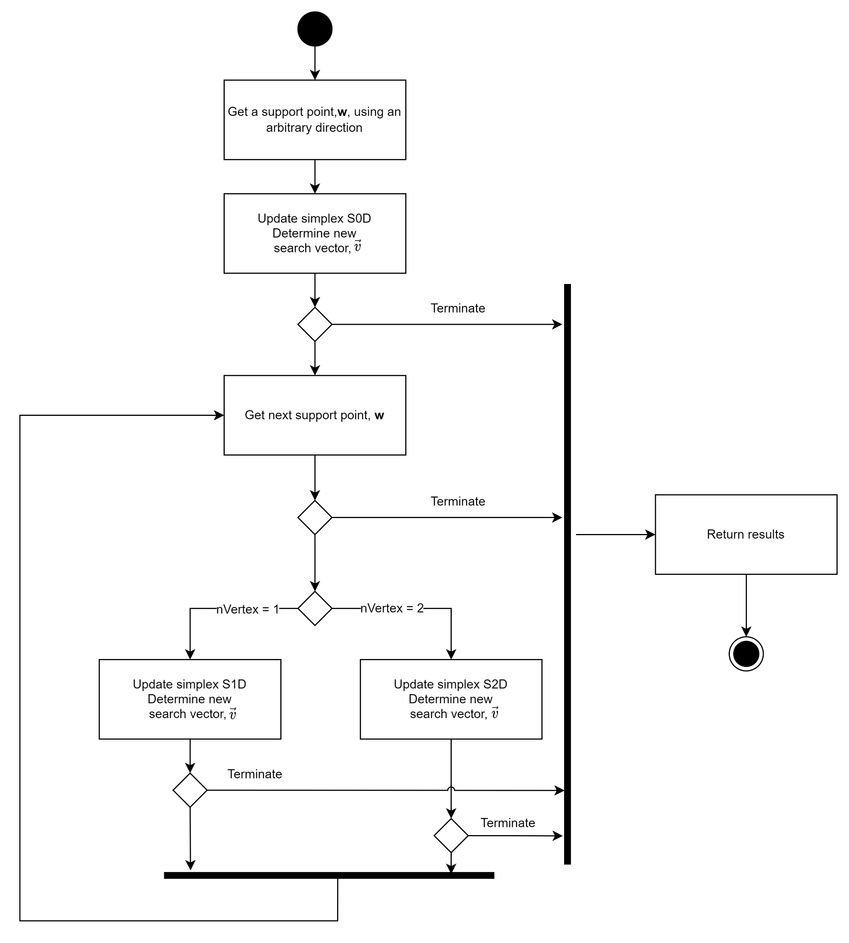
Summary

